Slide 1
Introduction to Azure SQL
Module 1

Slide 3
Learning Units covered in this Module
Lesson 1: Basic concepts of Azure SQL
Lesson 2: How to create Azure SQL Database

Slide 4
Lesson 1: Basic concepts of Azure SQL

Slide 5

Objectives
After completing this learning, you will be able to:
Describe the basic concept and architecture
Describe the difference between the purchase models.
Describe the service tiers compute and hardware generation of the Azure SQL Database.

Slide 6
What is Microsoft Azure?
Microsoft Azure is Microsoft’s public cloud computing platform
Over 140 countries across 60 regions worldwide
Windows and Linux
Scale globally
Reach more locations, faster, with the performance and reliability of a vast global infrastructure.
Safeguard data
Rely on industry-leading data security in the region and across our network.
Promote sustainability
Help build a clean-energy future and accelerate progress toward your sustainability goals.
Notes:
https://azure.microsoft.com/en-us/global-infrastructure/regions/
Microsoft Azure is Microsoft's public cloud computing platform and infrastructure for building, deploying, and managing applications and services through a global network of Microsoft-managed datacenters. It provides both PaaS and IaaS services and supports many different programming languages, tools and frameworks, including both Microsoft-specific and third-party software and systems. It consists of over 140 countries across 56 regions worldwide with more being added all the time. It provides hyper scale computing capabilities and makes up the top 3 networks in the world.
Azure regions
Azure has more global regions than any other cloud provider—offering the scale needed to bring applications closer to users around the world, preserving data residency, and offering comprehensive compliance and resiliency options for customers.
Scale globally
Reach more locations, faster, with the performance and reliability of a vast global infrastructure.
Safeguard data
Rely on industry-leading data security in the region and across our network.
Promote sustainability
Help build a clean-energy future and accelerate progress toward your sustainability goals.

Slide 7
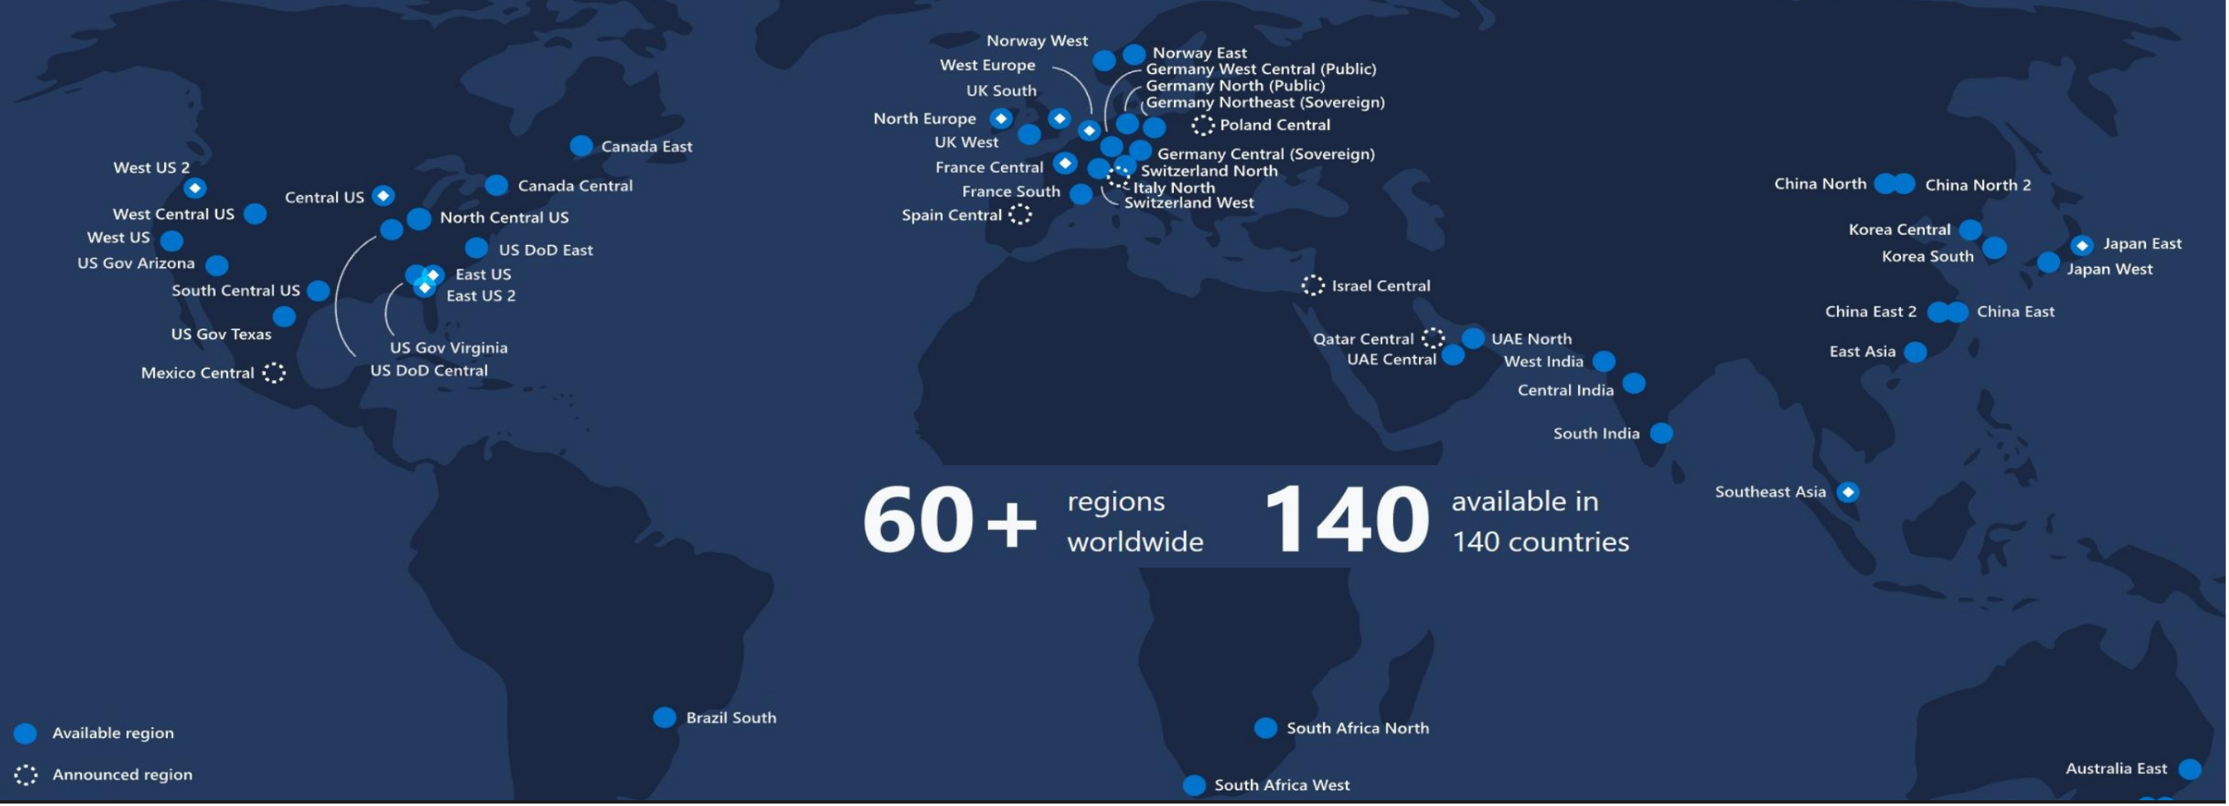
What is Microsoft Azure?
https://azure.microsoft.com/en-us/global-infrastructure/regions/
Notes:
https://azure.microsoft.com/en-us/global-infrastructure/regions/
Microsoft Azure is Microsoft's public cloud computing platform and infrastructure for building, deploying, and managing applications and services through a global network of Microsoft-managed datacenters. It provides both PaaS and IaaS services and supports many different programming languages, tools and frameworks, including both Microsoft-specific and third-party software and systems. It consists of over 140 countries across 56 regions worldwide with more being added all the time. It provides hyper scale computing capabilities and makes up the top 3 networks in the world.
Azure regions
Azure has more global regions than any other cloud provider—offering the scale needed to bring applications closer to users around the world, preserving data residency, and offering comprehensive compliance and resiliency options for customers.
Scale globally
Reach more locations, faster, with the performance and reliability of a vast global infrastructure.
Safeguard data
Rely on industry-leading data security in the region and across our network.
Promote sustainability
Help build a clean-energy future and accelerate progress toward your sustainability goals.

Slide 8
Benefits of Cloud Computing
On and Off
Inactivity
Period
On and off workloads (for example: batch job).
Over provisioned capacity is wasted.
Time to market can be cumbersome.
Compute
t
Growing Fast
Compute
Successful services needs to grow/scale.
Keeping up with growth is a big IT challenge.
Cannot provision hardware fast enough.
t
Unpredictable Bursting
Compute
Unexpected/unplanned peak in demand.
Sudden spike impacts performance.
Cannot over provision for extreme cases.
t
Predictable Bursting
Compute
Services with micro seasonality trends.
Peaks due to periodic increased demand.
IT complexity and wasted capacity.
t
Notes:
On and Off
On and off workloads (for example: batch job).
Over provisioned capacity is wasted.
Time to market can be cumbersome.
Growing Fast
Successful services needs to grow/scale.
Keeping up with growth is a big IT challenge.
Cannot provision hardware fast enough.
Unpredictable Bursting
Unexpected/unplanned peak in demand.
Sudden spike impacts performance.
Cannot over provision for extreme cases.
Predictable Bursting
Services with micro seasonality trends.
Peaks due to periodic increased demand.
IT complexity and wasted capacity.

Slide 9
Hosting Models
Managed by customer
Managed by Microsoft
On-premises
Infrastructure
(as a Service)
Platform
(as a Service)
On-premises costs tend to be driven by hardware and data center management costs
Infrastructure-as-a-Service reduces cost categories related to data center and compute
Platform-as-a-Service off-loads customers’ most administrative tasks to Azure, further improving efficiency with machine-learning capabilities for performance and security
Managed Instance: instance-level deployment for lift-shift existing apps to Azure, fully backward compatible
Single database: database-level deployment for new apps
Applications
Applications
Applications
Data
Data
Data
High availability /DR/Backups
High availability /DR/Backups
High Availability/ DR/Backups
Database Provision/ Patch/Scaling
Database Provision/ Patch/Scaling
Database Provision/ Patch/Scaling
O/S provision /patching
O/S
O/S
Virtualization
Virtualization
Virtualization
Hardware
Hardware
Hardware
Datacenter Management
Datacenter Management
Datacenter Management
SQL Server 2017/2019
Azure SQL VMs
Azure SQL Database
SQL Managed Instance
Notes:
Azure SQL Database is a fully-managed platform-as-a-service. This means Microsoft operates SQL Server for you, assuming much of the daily maintenance, administration and infrastructure costs of your IT organization.
Quickly realize spend and operational efficiencies you may not have otherwise experienced with your on-premises or hosted solution.
Along with ensured availability and performance, features of Azure SQL Database include:
Provisioning and resizing (w/ Azure Portal experience)
Built-in auto HA (99.99%)
Automatic backup
Point-in-time-restore (database-level)
Active geo-replication
Intelligent performance optimization and security of your databases

Slide 10
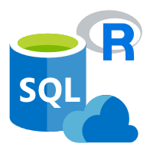
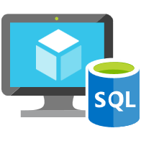

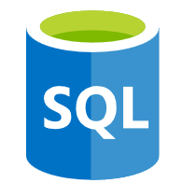
Data platform continuum
PaaS
Azure SQL Database
Virtualized Database
Shared lower cost
IaaS
SQL Server in Azure VM
Virtualized Machines
Virtual
SQL Server Private Cloud
Virtualized Machine + Appliance
Physical
SQL Server
Physical Machine (raw iron)
Dedicated higher cost
Higher administration
Lower administration
Notes:
Objective: One of the first things to understand in any discussion of Azure versus on-premises SQL Server databases is that you can use it all. The Microsoft data platform leverages SQL Server technology and makes it available across physical on-premises machines, private cloud environments, third-party hosted private cloud environments, and public cloud. This enables you to meet unique and diverse business needs through a combination of on-premises and cloud-hosted deployments, while using the same set of server products, development tools, and expertise across these environments.
Talking Points:
As seen in the diagram, each offering can be characterized by the level of administration you have over the infrastructure (on the X axis), and by the degree of cost efficiency achieved by database level consolidation and automation (on the Y axis).
When designing an application, four basic options are available for hosting the SQL Server part of the application:
SQL Server on nonvirtualized physical machines
SQL Server in on-premises virtualized machines (private cloud)
SQL Server in Azure Virtual Machine (public cloud)
Azure SQL Database (public cloud)

Slide 11
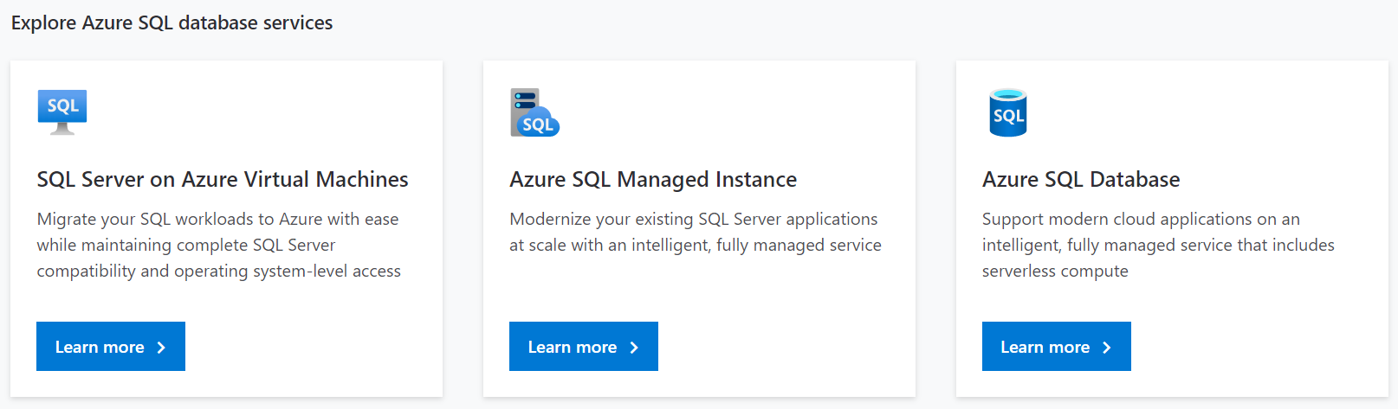
Azure SQL Family

Slide 12
A closer look… Best for
SQL Server in Azure VM
New applications or existing on-premises applications that want to use the latest stable SQL Server features and that are migrated to the cloud with minimal changes.
Teams that need built-in high availability, disaster recovery, and upgrade for the database.
Teams that do not want to manage the underlying operating system and configuration settings.
Databases of up to 8 TB, or larger databases that can be horizontally or vertically partitioned using a scale-out pattern.
New cloud-designed applications that want to use the latest stable SQL Server features and have time constraints in development and marketing.
Teams that need built-in high availability, disaster recovery, and upgrade for the database.
Teams that do not want to manage the underlying operating system and configuration settings.
Databases of up to 4 TB, or larger databases that can be horizontally or vertically partitioned using a scale-out pattern.
Azure SQL Datababase
Existing applications that require fast migration to the cloud with minimal changes or no changes.
Teams that can configure, fine tune, customize, and manage high availability, disaster recovery, and patching for SQL Server.
You need a customized environment with full administrative rights.
SQL Server instances with up to 64 TB of storage. The instance can support as many databases as needed.
Managed Instance
Notes:
Listed are the most common motivations to choose an Azure SQL Database or SQL Server running on an Azure VM or a Managed Instance as a hybrid solution.

Slide 13
Azure SQL Database Purchasing models and resources
Database Transaction Unit (DTU) model
Pre-packaged, bundled unit that represents the database power.
vCore model
À La carte approach deconstructs the DTU model into separate parts.
Customers can select compute and storage independently.
Allows customers to right-size their compute requirements in the cloud.
vCore sizing offers flexibility of choice.
Provides a choice between a provisioned compute tier and a serverless compute tier.
Designed for predictable performance, but somewhat inflexible and limited in options.
DTU sizing offers simplicity of choice.
Blended measure of CPU, memory, and read-write rates.
DTU model
Fixed scalability
Compute
Storage
New vCore model
Independent scalability
Compute
Storage
Notes:
DTU-based model:
This model is based on a bundled measure of compute, storage, and IO resources. Performance levels are expressed in terms of Database Transaction Units (DTUs) for single databases and elastic Database Transaction Units (eDTUs) for elastic pools. Best for customers who want simple, pre-configured resource options.
vCore-based model:
This model allows you to independently scale compute and storage resources. It also allows you to use Azure Hybrid Benefit for SQL Server to gain cost savings. Best for customers who value flexibility, control, and transparency.
In the vCore-based purchasing model, you pay for:
Compute resources (the service tier + the number of vCores and the amount of memory + the generation of hardware).
The type and amount of data and log storage.
Backup storage (RA-GRS).

Slide 14
Purchasing models available for Azure SQL Database deployment:
Purchasing model/ Deployment model | DTU based | vCore based
Single Database
Elastic Pool
Managed Instance
Hyperscale service tier (single databases)
Notes:
Different purchasing models are available for different Azure SQL Database deployment models:
The single database and elastic pool deployment options in Azure SQL Database offer both the DTU-based purchasing model and the vCore-based purchasing model.
The managed instance deployment option in Azure SQL Database offers only the vCore-based purchasing model.
The hyperscale service tier is available for single databases that are using the vCore-based purchasing model.

Slide 15
Overview Service Tiers
DTU based
Basic
Standard
Premium
vCore based
General purpose.
Business critical
Hyperscale
Standard 100DTUs = 1vCore
Premium 125DTUs = 1vCore
Notes:
In the DTU-based purchasing model, you can choose between the basic, standard, and premium service tiers for both single databases and elastic pools. The DTU-based purchasing model isn't available for managed instances.
In the vCore-based purchasing model, you can choose between the general purpose and business critical service tiers for single databases, elastic pools, and managed instances. For single databases, you can also choose the hyperscale service tier.
Note: Serverless is not a Service Tier is a compute type available in the General Purpose Service Tier.
* Fsv2-series and M-series are GA but available in specific regions
https://docs.microsoft.com/en-us/azure/azure-sql/database/service-tiers-vcore?tabs=azure-portal#hardware-generations

Slide 16
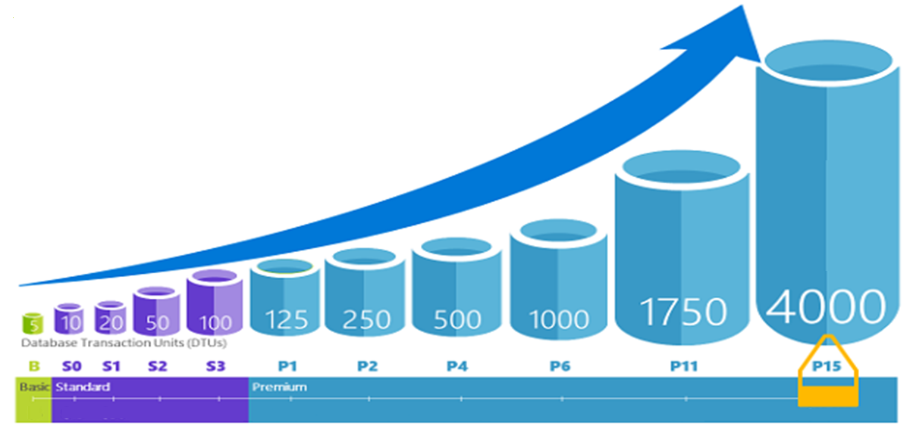
Database Transaction Units (DTUs)
Notes:
For a single Azure SQL database at a specific performance level within a service tier, Microsoft guarantees a certain level of resources for that database (independent of any other database in the Azure cloud) and providing a predictable level of performance. This amount of resources is calculated as a number of Database Transaction Units or DTUs, and is a blended measure of CPU, memory, I/O (data and transaction log I/O). Doubling the DTUs by increasing the performance level of a database is the same as doubling the set of resource available to that database. For example, a Premium P11 database with 1750 DTUs provides 350x more DTU compute power than a Basic database with 5 DTUs.
How can I determine the number of DTUs needed by my workload?
If you are looking to migrate an existing on-premises or SQL Server virtual machine workload to Azure SQL Database, you can use the DTU Calculator to approximate the number of DTUs needed.

Slide 17
DTU-based model: Service Tiers
 | Basic | Standard |  |  |  |  |  |  |  |  | Premium
 |  | S0 | S1 | S2 | S3 | S4 | S6 | S7 | S9 | S12 | P1 | P2 | P4 | P6 | P11 | P15
Built for | Light transactional workloads | Medium transactional workloads |  |  |  |  |  |  |  |  | Heavy transactional workloads
Available SLA | 99.99%
Database max. size | 2 GB | 250 GB |  |  | 1 TB |  |  |  |  |  |  |  |  |  | 4 TB
Point-in-time restore (“oops” recovery) | Any point within 7 days | 7-35 days (7 days by default)
Business continuity | Active geo-replication, up to four readable secondary backups
Security | Auditing, row-level security, dynamic data masking, Advanced Threat Protection
Performance objectives | Transactions per hour | Transactions per minute |  |  |  |  |  |  |  |  | Transactions per second
Database transaction units (DTUs) | 5 | 10 | 20 | 50 | 100 | 200 | 400 | 800 | 1,600 | 3,000 | 125 | 250 | 500 | 1,000 | 1,750 | 4,000
$
Resource limits for single databases using the DTU-based purchasing model
$$$
Notes:
All three service tiers have an uptime SLA of 99.99%
Basic:
Basic tier is designed for applications with a light transactional workload. A typical use case is a lightweight application that needs a small database with a single operation at any given point in time.
Standard:
Standard tier is the go-to option for getting started with transactional workloads. It offers better performance and better built-in business continuity features compared to Basic tier. A typical use case is an application with multiple concurrent transactions.
Premium:
Premium tier is designed for mission-critical applications. It offers the best level of performance and access to advanced business continuity features including active geo-replication in up to 4 Azure regions of your choice. A typical use case is a mission-critical application with high transactional volume and many concurrent users.
https://docs.microsoft.com/en-gb/azure/azure-sql/database/service-tiers-dtu#compare-the-dtu-based-service-tiers

Slide 18
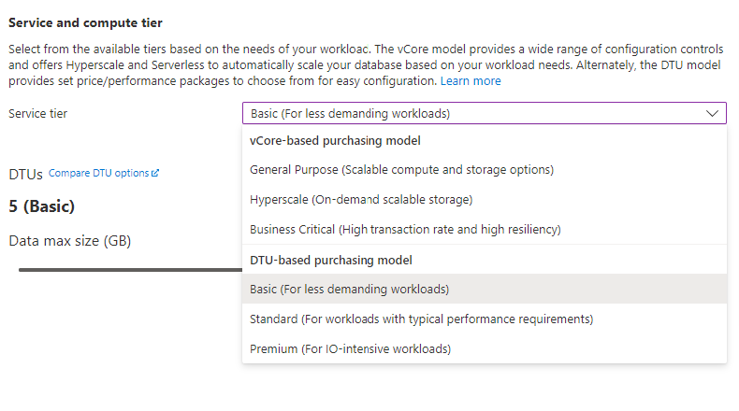
Changing Performance Levels (DTU)
PowerShell
Set-AzSqlDatabase
REST
Update database
Azure CLI
az sql db update
T-SQL
ALTER DATABASE … MODIFY (EDITION = …)
Notes:
You can change the service tier and performance level of your SQL database with the Azure portal, PowerShell (using the Set-AzureSqlRmDatabase cmdlet), the Service Management REST API (using the Update Database command), or Transact-SQL (via the ALTER DATABASE statement). You can use DMVs to monitor the progress of the upgrade operation for a database. This allows you to easily scale up or down a database, and it will remain online and available during the entire operation with no downtime.
https://docs.microsoft.com/en-us/azure/sql-database/sql-database-manage-single-databases-powershell
https://docs.microsoft.com/en-us/azure/sql-database/sql-database-manage-single-databases-portal

Slide 19
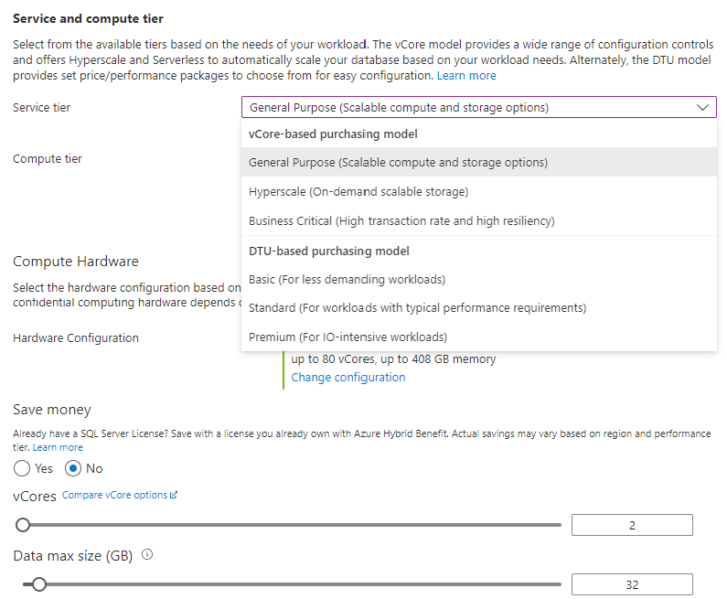
Changing Performance Levels (vCore)
PowerShell
Set-AzSqlDatabase
REST
Update database
Azure CLI
az sql db update
T-SQL
ALTER DATABASE … MODIFY (EDITION = …)
Notes:
You can change the service tier and performance level of your SQL database with the Azure portal, PowerShell (using the Set-AzureRmSqlDatabase cmdlet), the Service Management REST API (using the Update Database command), or Transact-SQL (via the ALTER DATABASE statement). You can use DMVs to monitor the progress of the upgrade operation for a database. This allows you to easily scale up or down a database, and it will remain online and available during the entire operation with no downtime.
https://docs.microsoft.com/en-us/azure/sql-database/sql-database-manage-single-databases-powershell
https://docs.microsoft.com/en-us/azure/sql-database/sql-database-manage-single-databases-portal

Slide 20
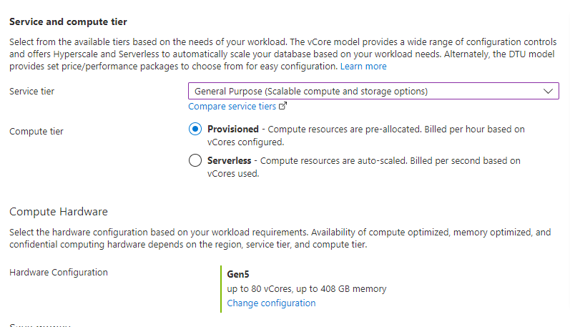
Changing Compute Tier and Hardware (vCore)
Notes:
You can change the service tier and performance level of your SQL database with the Azure portal, PowerShell (using the Set-AzureRmSqlDatabase cmdlet), the Service Management REST API (using the Update Database command), or Transact-SQL (via the ALTER DATABASE statement). You can use DMVs to monitor the progress of the upgrade operation for a database. This allows you to easily scale up or down a database, and it will remain online and available during the entire operation with no downtime.
https://docs.microsoft.com/en-us/azure/sql-database/sql-database-manage-single-databases-powershell
https://docs.microsoft.com/en-us/azure/sql-database/sql-database-manage-single-databases-portal

Slide 21
vCore-based purchasing model: Provisioned compute tier
Service tier | General purpose |  | Business critical |  | Hyperscale
Best for | Most budget-oriented workloads |  | Critical business applications with high IO requirements. |  | VLDB OLTP and HTAP workloads with highly scalable storage and read-scale requirements.
Deployment option | Single / Elastic Pools | Managed Instance | Single / Elastic Pools | Managed Instance | Single
Compute tiers | Gen5: 2 to 80 vCore Fsv2-series*: 72 vCore Serverless: 0.5 to 16 vCore | Gen5: 4 to 80 vCore | Gen5: 2 to 80 vCore M-series*: 128 vCore | Gen5: 4 to 80 vCore | Gen5: 2 to 80 vCore
Storage | Premium remote |  | Local SSD |  | Local SSD Cache
 | 5GB – 4TB per instance | 32GB – 16TB per instance | 5GB – 4TB per instance | 32GB – 16TB per instance | Scale from 5GB to 100TB of storage in 1GB increments
In-Memory | Not supported |  | Supported |  | Not supported
Read-write IO | ~2ms for all data access |  | <0.5ms for all data access |  | <0.5ms for hot data access ~2ms otherwise
Availability | 1 replica, no read-scale replicas |  | 3 read replicas, zone-redundant HA | 3 replicas, 1 read-scale replica, zone-redundant HA | Primary read/write replica + up to 4 read replicas
Backups | RA-GRS, 7-35 days (7 days by default) |  | RA-GRS, 7-35 days (7 days by default) |  | LRS, ZRS, RA-GRS, 7-35 days (7 days by default)
For latest information reference: https://azure.microsoft.com/en-us/pricing/details/sql-database/
* Fsv2-series and M-series are currently in preview.
Notes:
vCore-based purchasing model: General purpose, hyperscale, and business critical
These service tiers are differentiated by a range of compute sizes, high-availability designs, fault-isolation methods, types and sizes of storage, and I/O
https://docs.microsoft.com/en-us/azure/sql-database/sql-database-service-tiers-vcore
https://azure.microsoft.com/en-us/pricing/details/sql-database/
vCore model so we can get AHB: 1 Enterprise license core = 1 Business Critical core
Business critical because online gaming wants the highest performance and HA
Gen 5 so we can scale our compute more
Also for read-scale replica, zone redundant HA
Zone Redundant Storage (ZRS) replicates your data synchronously across three storage clusters in a single region. Each storage cluster is physically separated from the others and is located in its own availability zone (AZ). Each availability zone—and the ZRS cluster within it—is autonomous and includes separate utilities and networking features. A write request to a ZRS storage account returns successfully only after the data is written to all replicas across the three clusters.
When you store your data in a storage account using ZRS replication, you can continue to access and manage your data if an availability zone becomes unavailable. ZRS provides excellent performance and low latency. ZRS offers the same scalability targets as locally redundant storage (LRS).

Slide 22
Choose from hardware generations
 | Gen 5 | Fsv2-series | M-series | DC-Series
Hardware | Intel E5-2673 v4 (Broadwell) 2.3 GHz processors, fast eNVM SSD vCore=1 LP (hyper-thread) | Intel Xeon Platinum 8168 (SkyLake) processors | Intel Xeon E7-8890 v3 2.5 GHz processors | Intel® XEON E-2288G processors. Featuring Intel Software Guard Extension (Intel SGX))
Performance levels | 1 to 80 vCores | 72 vCores (1 vCore = 1 hyper-thread) | 128 vCores (1 vCore = 1 hyper-thread) | Provision up to 8 vCores (physical)
Memory | 5.1 GB per vCore for provisioned compute Up to 24 GB per vCore for serverless compute | 1.9 GB per vCore | 29 GB per vCore | 4.5 GB per vCore
Storage | Up to 4TB remote SSD storage Up to 4TB local SSD storage | Up to 4TB remote SSD storage | Up to 4TB local SSD storage | Up to 4TB remote SSD storage
Balance performance requirements and price with two hardware generations
Match your on-premises application behavior
Fsv2, M, and DC series are Generally available but in limited regions
Notes:
In terms of the vCore-based purchasing model, you will be able to further balance price and performance requirements with the ability to choose between different hardware generations. Microsoft’s goal is to enable maximum flexibility so you can choose a performance configuration that most closely matches the needs of your application. In particular, Gen 4 hardware offers more memory per vCore. However, Gen 5 hardware allows you to scale up compute much higher. Microsoft wants to make these differences transparent so you can achieve the optimal price/performance ratio for your application.
Hardware generation options in the vCore model include Gen 4/5, M-series (preview), and Fsv2-series (preview). The hardware generation generally defines the compute and memory limits and other characteristics that impact the performance of the workload.
Gen4/Gen5
Gen4/Gen5 hardware provides balanced compute and memory resources, and is suitable for most database workloads that do not have higher memory, higher vCore, or faster single vCore requirements as provided by Fsv2-series or M-series.
For regions where Gen4/Gen5 is available, see Gen4/Gen5 availability.
Fsv2-series (preview)
Fsv2-series is a compute optimized hardware option delivering low CPU latency and high clock speed for the most CPU demanding workloads.
Depending on the workload, Fsv2-series can deliver more CPU performance per vCore than Gen5, and the 72 vCore size can provide more CPU performance for less cost than 80 vCores on Gen5.
Fsv2 provides less memory and tempdb per vCore than other hardware so workloads sensitive to those limits may want to consider Gen5 or M-series instead.
For regions where Fsv2-series is available, see Fsv2-series availability.
M-series (preview)
M-series is a memory optimized hardware option for workloads demanding more memory and higher compute limits than provided by Gen5.
M-series provides 29 GB per vCore and 128 vCores, which increases the memory limit relative to Gen5 by 8x to nearly 4 TB.
To enable M-series hardware for a subscription and region, a support request must be open. If the support request is approved, then the selection and provisioning experience of M-series follows the same pattern as for other hardware generations. For regions where M-series is available, see M-series availability.

Slide 23
vCore-based purchasing model: Serverless compute tier
On-demand flexible scale
Operate at the true rhythm of your business.
Cost-effective
Pay for performance. Period.
Fully managed & intelligent
Focus on your applications, not your infrastructure
Adapts compute resources to the workload without sacrificing performance.
Automatically pauses and resumes.
Pay only for compute resources you consume, on a per-second basis.
Further optimize costs with configurable compute thresholds.
Fully-managed and intelligent database service.
Built-in 99.99% availability.
Best for unpredictable and intermittent workloads on single databases, such as:
Dev/test
Line of Business
E-commerce
Notes:
Azure SQL Database serverless is our answer to cost-effectively resourcing these types of unpredictable and intermittent workloads. It is a dynamically scaling, on-demand version of Azure SQL Database that eliminates the complexity of resourcing and managing unpredictable workloads. Simply create a serverless database and connect your application, with no upfront resource configuration required. Serverless SQL databases automatically pause, resume and scale compute based upon your app’s requirements, making them particularly cost effective for variable or unpredictable workloads – or when you’re simply unsure of your requirements.
With resources available on-demand, serverless SQL databases optimize costs with pay per-second billing that aligns with the app’s performance, so you only pay for the compute resources you use .
Built upon the SQL Server architecture, serverless SQL databases are fully-managed, always up to date and highly available with a 99.99% uptime guarantee. Combined with built-in intelligence to optimize database performance and security, serverless SQL Databases help you be more productive so you can focus more on what you do best, building great apps faster and more cost effectively.

Slide 24
Provisioned compute and serverless meet different needs
Optimize compute provisioning and billing for your workload
Databases with provisioned compute…
Serverless databases…
Provision compute resources upfront.
Bill on an hourly basis.
Scale up or down to meet workload requirements, instead of pre-provisioning.
Bill on a per-second basis.
Common scenarios
Common scenarios
Workloads with regular and substantial compute utilization.
Multiple databases with bursty usage patterns that can be consolidated into a single server and use elastic pools for better price optimization.
Workloads with unpredictable and intermittent usage patterns or performance requirements .
Workloads where the requirements are unknown, and you can delegate compute sizing to the service.
Notes:
Provisioned compute and serverless options meet different needs. Ultimately, you need to determine the option that will provide you with the best price and performance for the type(s) of workloads that you have.

Slide 25
Serverless price to performance with per-second billing
Compute resources scale dynamically up or down based on workload requirements.
Configure minimum and maximum vCores to define the range of available compute capacity.
Use auto-pause delay to define the time period the dataset must be inactive before pausing.
Pay for compute based on the vCores and memory used per second, with lowest billing based on configured vCore minimum.
When the database is paused, the compute cost is zero and only storage costs are incurred.
The database is automatically resumed when the next login or other activity occurs.
CPU usage
4
Inactive
Paused
Number vCores
1
0
8:00
9:00
10:00
11:00
12:00
13:00
14:00
15:00
16:00
17:00
18:00
19:00
20:00
21:00
22:00
23:00
0:00
1:00
2:00
3:00
4:00
5:00
6:00
7:00
8:00
Min vcores
Max vcores
Vcores used
Vcores billed
Notes:
Serverless automatically scales compute for single databases based on workload demand and bills for compute used per second. In serverless, compute scaling within configurable limits is managed by the service to continuously right-size resources. Serverless also provides an option to automatically pause the database during inactive usage periods and automatically resume when activity returns. During periods of inactivity, you only pay for storage.

Slide 26
Lesson 2: How to create Azure SQL Database
Notes:
In this lesson we will be covering the prerequisites for Azure SQL Database and how to create a database.

Slide 27
Objectives
After completing this learning, you will be able to:
Know which prerequisites are needed before you can create an Azure SQL Database.
Create your first Azure SQL Database.

Slide 28
Azure SQL Database Server is not a machine...
SQL Server
A Machine
Azure SQL Database Server
TDS* Endpoint
*TDS = Tabular Data Stream
Notes:
A SQL Server is typically hosted on a physical or virtual machine and is referred to as an “instance” of SQL Server.
An Azure SQL Database Server is referred to as a logical server. It looks like a SQL Server instance, but it is technically a TDS (Tabular Data Stream) endpoint running as a microservice. Azure routes your requests to the physical primary replica of the database.

Slide 29
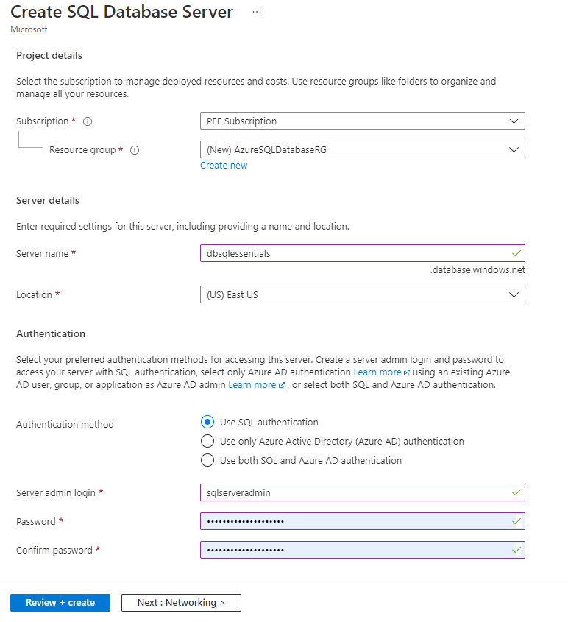
Server Provisioning
Service head that contains databases
Connect via Fully Qualified Domain Name
Initially contains only a master database
Notes:
We have the concept of a logical SQL Server but it’s just a logical grouping of databases.
You get a Fully Qualified Domain Name (FQDN) from Azure. That’s included in your connections string as normal and initially the only database visible is the master system database
To provision a logical SQL Server using the Azure Portal:
Log on to the portal
Select ‘Create a resource’
Search the Marketplace box for ‘SQL server (logical server)’
Click Create
Specify the following parameters:
Basics
Subscription
Resource group
Server name
Location
Server admin login
Password
Networking
Firewall rules, allow Azure services and resources to access this server (Yes/No)
Advanced data security
Enable advanced data security (Start free trial/Not now)
You can also use Azure PowerShell or Command Line Interface (CLI) to provision the logical SQL Server.

Slide 30
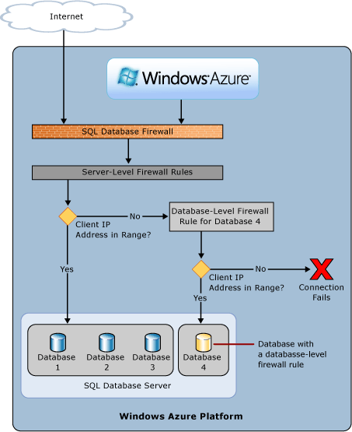
Azure SQL Database Firewall
IP Address-based access control for SQL Database
Rules at the server and/or database level
No IP authorized by default, not even Azure itself
Notes:
Firewall overview
Initially, all Transact-SQL access to your Azure SQL Server is blocked by the firewall. To begin using your Azure SQL Server, you can specify one or more server-level firewall rules that enable access. Use the firewall rules to specify which IP address ranges from the Internet are allowed, and whether Azure applications can attempt to connect to your Azure SQL Server. Of course, additionally, a login and password is still required for access.
To selectively grant access to just one of the databases in your Azure SQL Server, you must create a database-level rule for the required database. Specify an IP address range for the database firewall rule that is outside the IP address range specified in the server-level firewall rule, and ensure that the IP address of the client falls in the range specified in the database-level rule.
Connection attempts from the Internet and Azure must first pass through the firewall before they can reach your Azure SQL Server or SQL Database, as shown in the diagram:
Server-level firewall rules: These rules enable clients to access your entire Azure SQL Server, that is, all the databases within the same logical server. These rules are stored in the master database. Server-level firewall rules can be configured by using the portal or by using Transact-SQL statements. To create server-level firewall rules using the Azure portal or PowerShell, you must be the subscription owner or a subscription contributor. To create a server-level firewall rule using Transact-SQL, you must connect to the SQL Database instance as the server-level principal login or the Azure Active Directory administrator (which means that a server-level firewall rule must first be created by a user with Azure-level permissions).
Database-level firewall rules: These rules enable clients to access certain (secure) databases within the same logical server. You can create these rules for each database (including the master database) and they are stored in the individual databases. Database-level firewall rules for master and user databases can only be created and managed by using Transact-SQL statements and only after you have configured the first server-level firewall. If you specify an IP address range in the database-level firewall rule that is outside the range specified in the server-level firewall rule, only those clients that have IP addresses in the database-level range can access the database. You can have a maximum of 128 database-level firewall rules for a database. For more information on configuring database-level firewall rules, see the example later in this article and see sp_set_database_firewall_rule (Azure SQL Databases).
Recommendation: Microsoft recommends using database-level firewall rules whenever possible to enhance security and to make your database more portable. Use server-level firewall rules for administrators and when you have many databases that have the same access requirements and you don't want to spend time configuring each database individually.
Further details will be discussed in the security module.

Slide 31
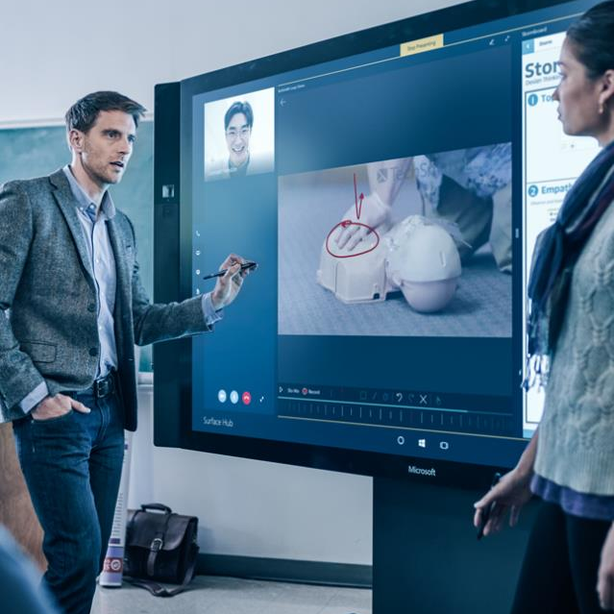
Demonstration
Create your first Azure SQL Database
Create a new server, configure the firewall rules and create an Azure SQL Database (DTU based).
Notes:
M01L02Demo01
Demo setup instructions
The latest version of the SQL Server Management Studio
Steps
Connect to the Azure Portal, click on “Create a resource” and search for SQL Server (logical server)
Create a logical server
Server Name myazuresrv (if the name is already in use, try another name until you notice that it’s not yet in use)
Server Admin Login AzureAdmin
Password Passw0rd1
Confirm password Passw0rd1
Subscription Select your subscription
Resource Group Create New and specify the name AzureDB-RG
Location Select the location that is the closest to your location
3. Examine the different server options (Failover Groups, Manage backups, AD Admin, Security, Automatic Tuning…) Give a short overview, not in detail because this will be discussed later in the Workshop.
4. Create the firewall rules on the logical server. Add the Client IP address.
5. Create Azure SQL Database with the portal. Go to your logical server – Overview – Click on New database
Database name Salesdb
Source Database Blank Database
Server This should be your logical server name
Want to use SQL elastic pool? Not now
Pricing Tier Basic
Collation SQL_Latin1_General_CP1_CI_AS

Slide 32

Questions?

Slide 33
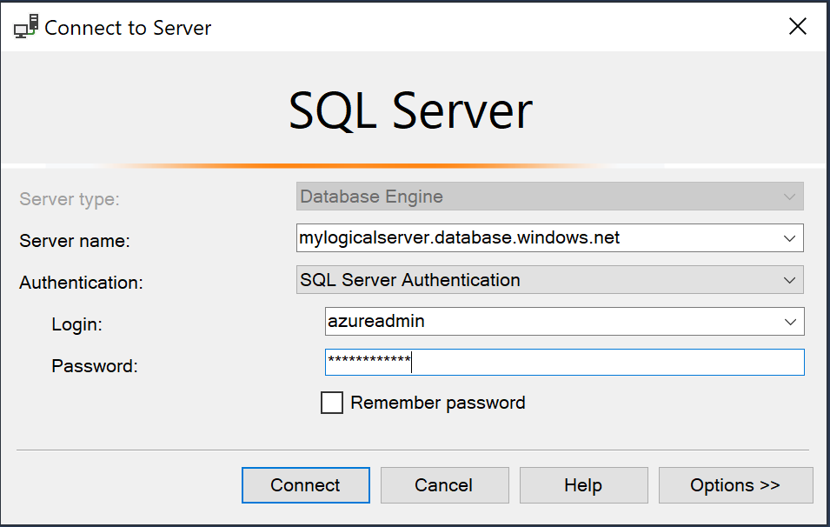
SQL Server Management Studio
Download the latest version of SSMS.
Get the fully qualified domain name of your Azure SQL Server.
Connect to your SQL Database.
Notes:
You can use SQL Server Management Studio (SSMS) by providing your FQDN:
<Server name>.database.windows.net
And providing a valid Login and Password.
Always use the latest version of SSMS because it is continually improved to work with the latest updates to Azure and SQL Database. Some old versions of management cannot connect to a SQL Azure database.

Slide 34
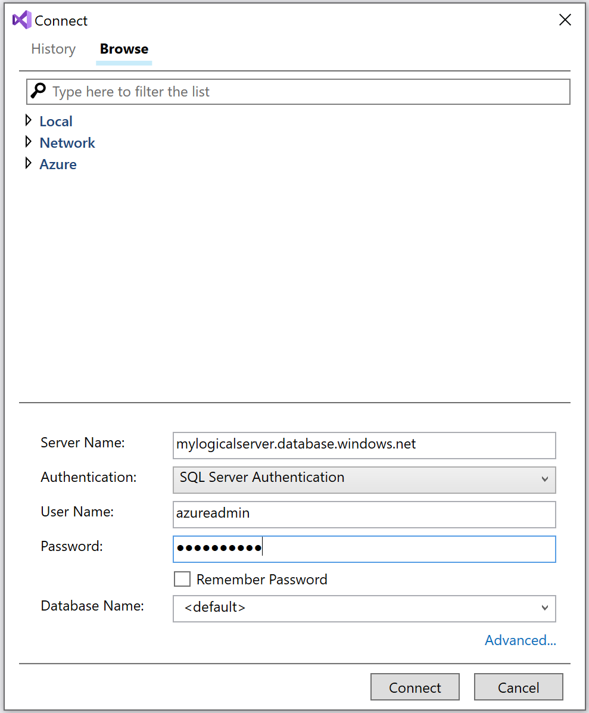
SQL Server Data Tools
Download the latest version of SSDT.
Get the fully qualified domain name of your Azure SQL Server.
Connect to your SQL Database.
Notes:
You can use SQL Server Data Tools (SSDT) by providing your FQDN:
<Server name>.database.windows.net
And providing a valid Login and Password.

Slide 35
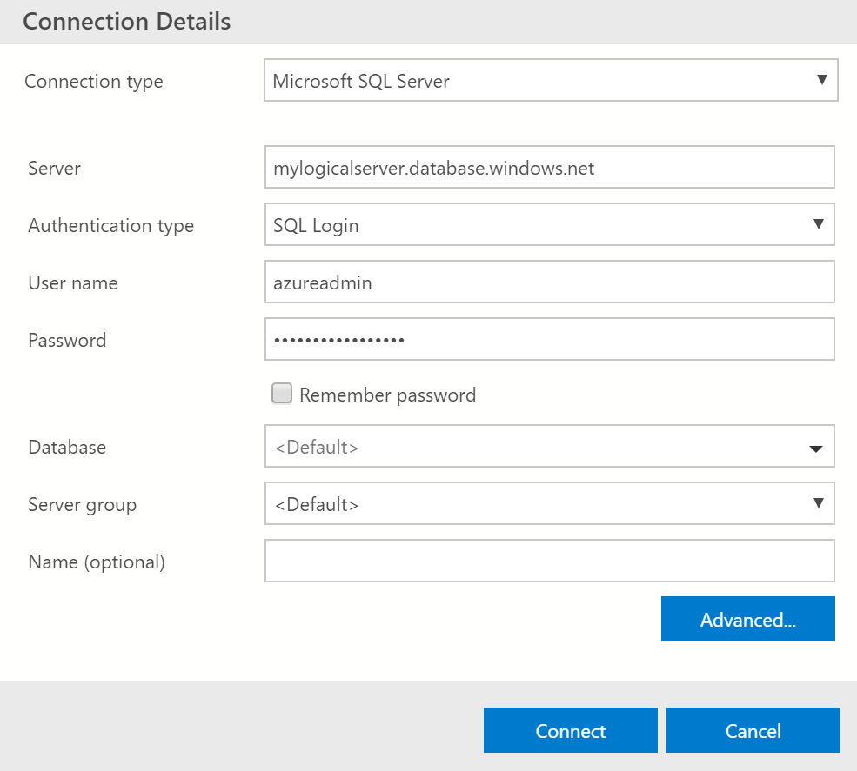
Azure Data Studio
Download the latest version of Azure Data Studio.
Get the fully qualified domain name of your Azure SQL Server.
Connect to your SQL Database.
Notes:
Azure Data Studio is a cross-platform database tool for data professionals running on Windows, MacOS, and Linux which offers a modern editor experience with Intellisense, code snippets, source control integration, and an integrated terminal. It is engineered with built in charting of query result sets and customizable dashboards.

Slide 36
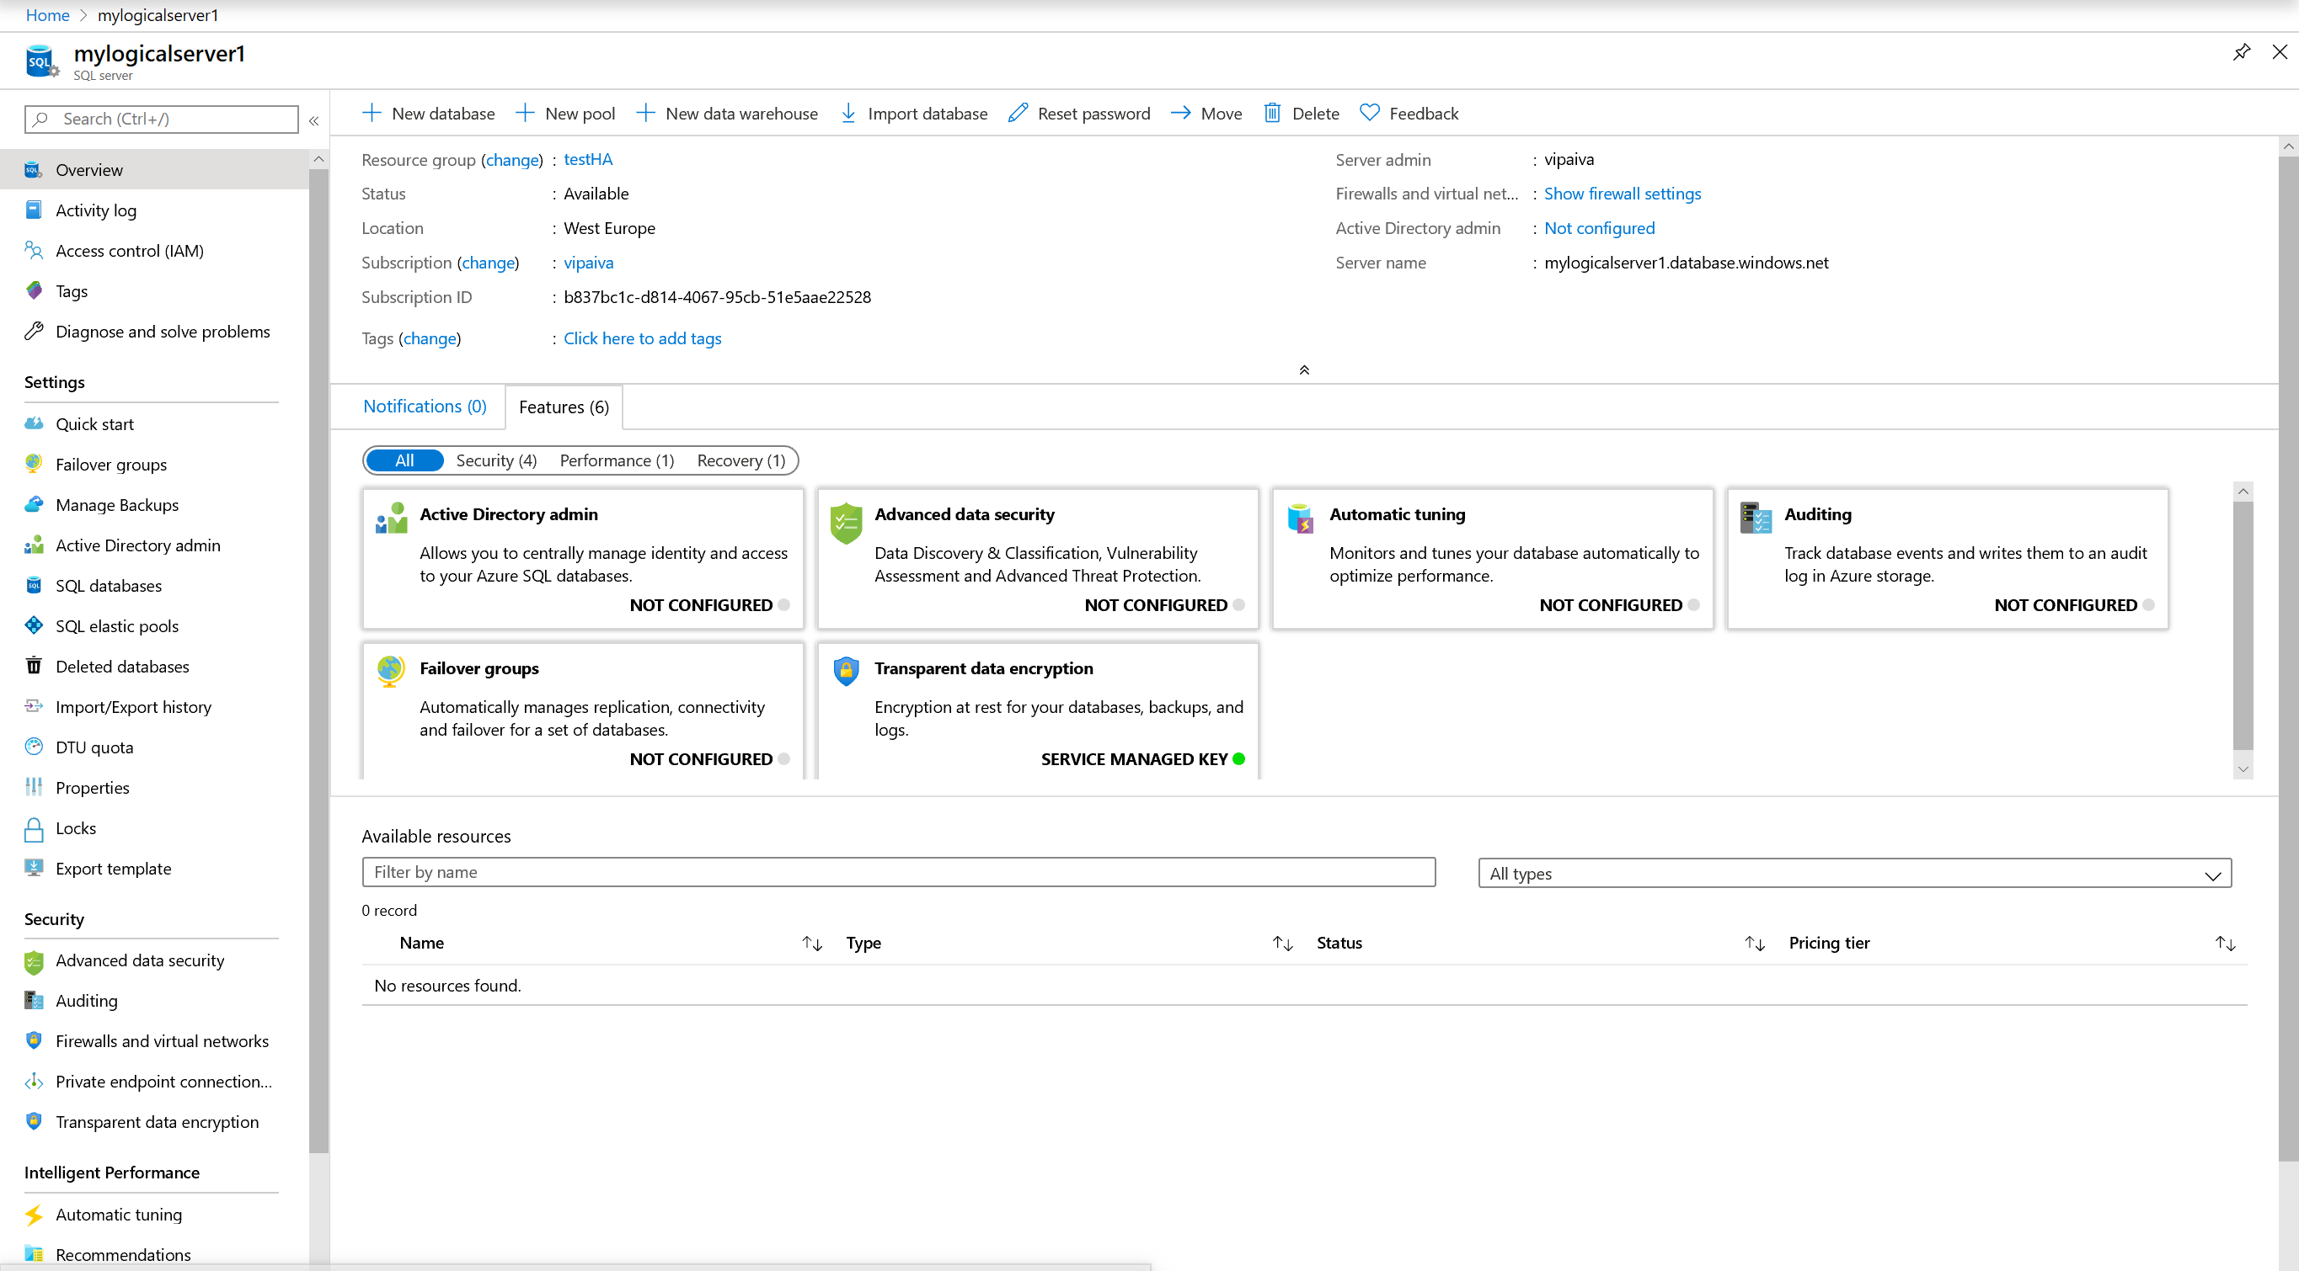
Azure Portal
Notes:
The Azure portal is a web-based application where you can create, update, and delete databases and logical servers and monitor database activity. This tool is great if you're just getting started with Azure, managing a few databases, or need to do something quickly.
https://docs.microsoft.com/en-us/azure/sql-database/sql-database-manage-portal

